Slide 1



Department of Electronics & Communication Engineering
B.P.Poddar Institute of Management & Technology
137, V.I.P Road. Poddar Vihar
Kolkata – 700 052.
Design of DGS Integrated MIMO Antenna for the IoT Application
Group No. 11
Supervisor: Dr. Susmita Biswas
Group Members:-
-Rouhi Ray(11500319065)
-Suparna Bhowal(11500319031)
-Sushmita Singh(11500319061)
-Shanu Mondal(11500320094)

Slide 2
ABSTRACT
The present and future wireless communication systems, WiFi, fourth generation (4G), fifth generation (5G), Beyond5G and sixth generation (6G), are a mixture of many frequency spectrums. This project presents the design and analysis of a compact MIMO (Multiple Input Multiple Output) antenna for wireless communication. The MIMO antenna is designed with size optimization considering the operating frequency at 2.4 GHz. The required mathematical calculation has been performed. The antenna is designed using ANSYS High Frequency Structure Simulator (HFSS) software. The designed antennas were simulated. The antenna would be fabricated and the results would be measured after the simulation. The result of this proposed compact MIMO antenna system shows wide bandwidth, high data rate and good amount of physical and virtual size reduction, which are promising proposed compact MIMO antennas suitable for next generation wireless application systems.

Slide 3
INTRODUCTION
MIMO (multiple input, multiple output) is an efficient transmission technology used in modern wireless communication. As the name implies, MIMO uses multiple antennas for transmission and reception. Combination of multiple transmission sources enhances higher data rate and system efficiency.
This is especially important in IoT applications where real-time data transmission is critical, such as in remote monitoring, security and surveillance, and emergency response systems. Some of the popular wireless technologies used in IoT applications are Wi-Fi, Bluetooth, WLAN, and ZigBee, which operate in the 2.4 GHz to 5 GHz frequency band.

Slide 4
FLOWCHART
START
Introduce DGS Structure in Ground Plane
Selection of Frequency
Design Model of MIMO in 3D HFSS
Selection of Substrate with Dielectric Constant and height
FAIL
Optimizations, Modifications & Parameter inspection
Performance evaluation by simulation parameter check
Calculation of Length of Radiating Patch
PASS
Finalize the Feeding Method
Antenna Manufacture
END

Slide 5

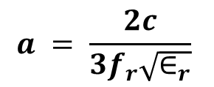
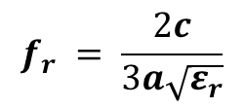
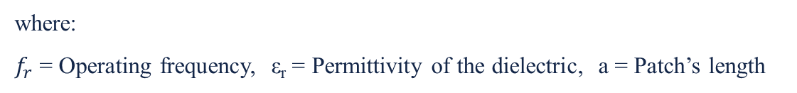

MATHEMATICAL CALCULATION
Resonance frequency is given-
$$f_{r} = \frac{2c}{3a\sqrt{ε_{r}}}$$
(1)
From above equation (1) we get,
$$a = \frac{2c}{3f_{r}\sqrt{∈_{r}}}$$
In order to demonstrate the design of proposed antenna with a frequency range of 2.4GHz, Rogers RO3003 substrate with relative permittivity ε_{r} = 3, and thickness (h) = 6mm. By performing mathematical analysis, the Length of Patch is calculated.
$a = \frac{2∗3∗{10}^{8}}{3∗2.4∗{10}^{9}\sqrt{3}}$ mm
$$≈48 mm$$
where:
$f_{r}$ = Operating frequency, ε_{r} = Permittivity of the dielectric, a = Patch’s length
60°
60°
a
While designing, we have used Patch’s length(a) = 37.9 mm as we get good result using this value.

Slide 6
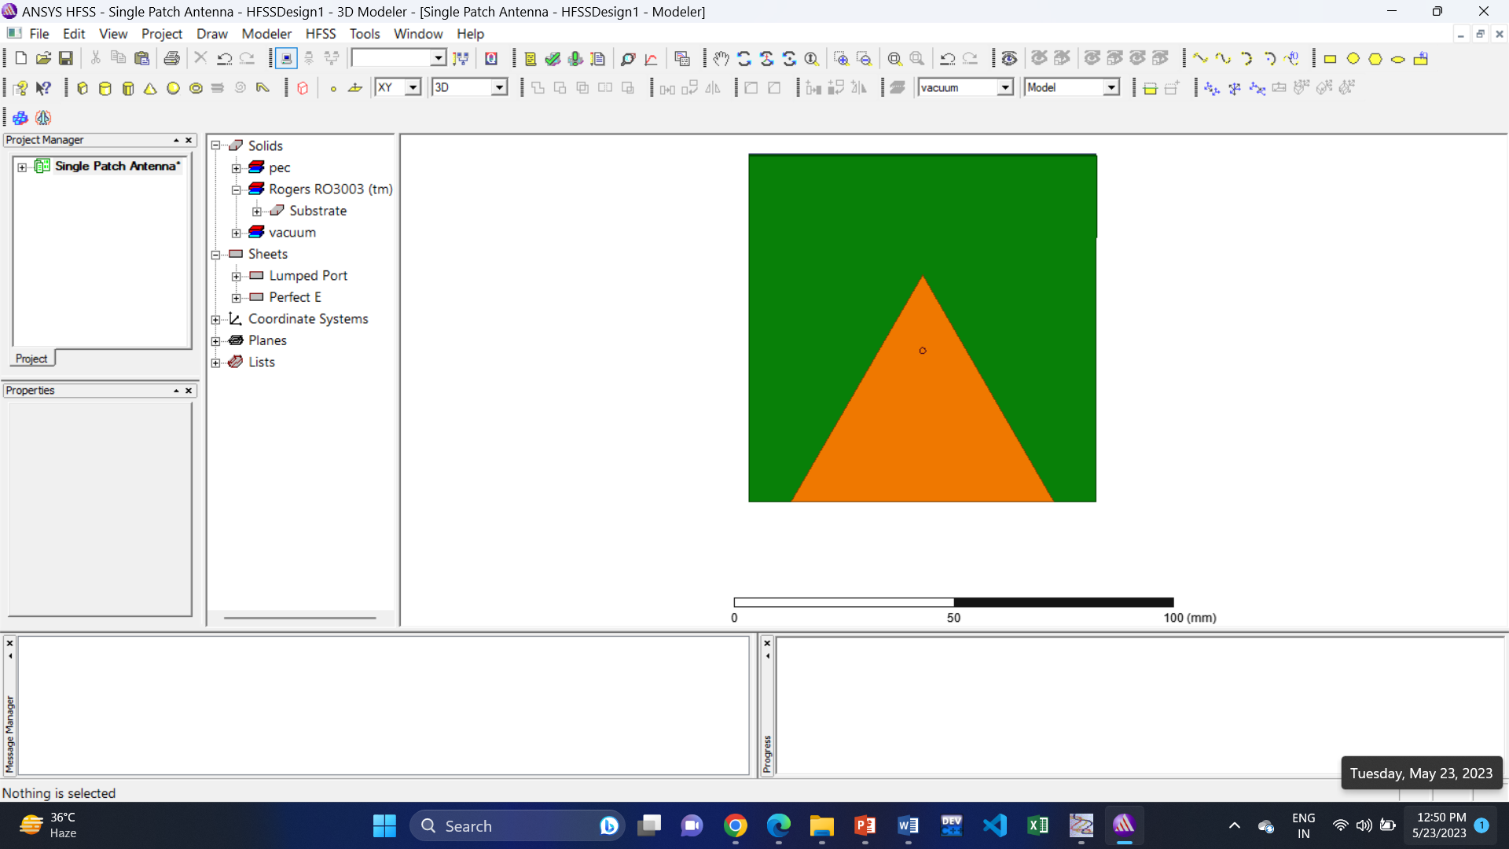
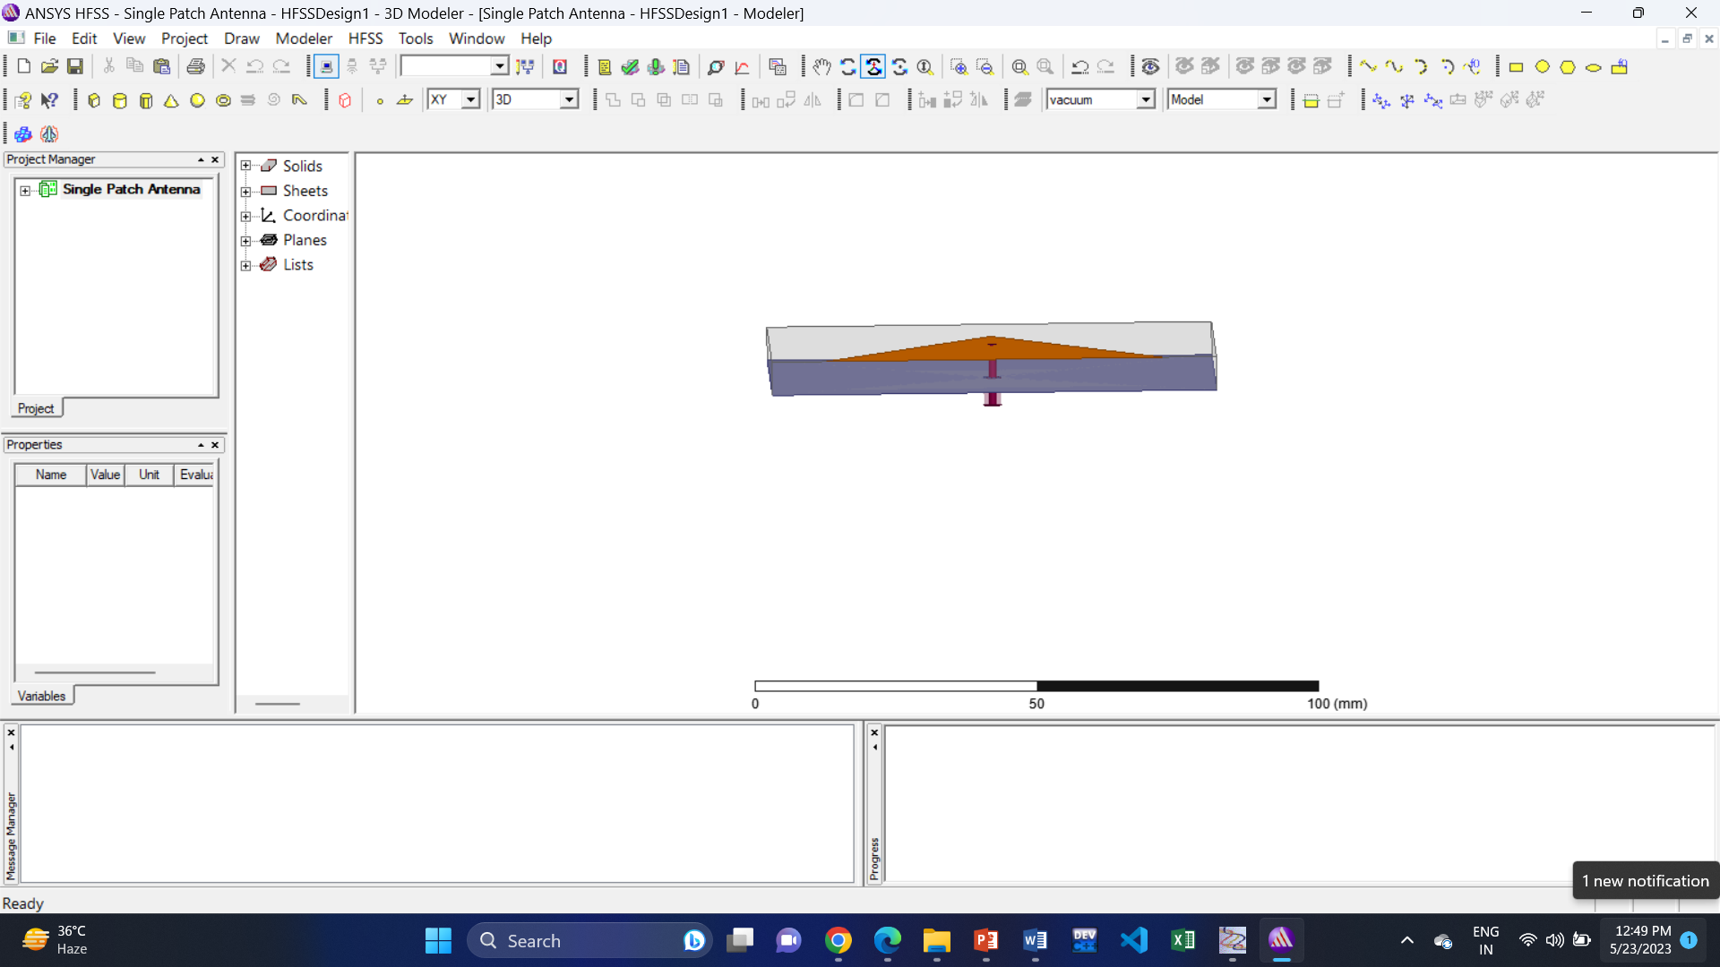
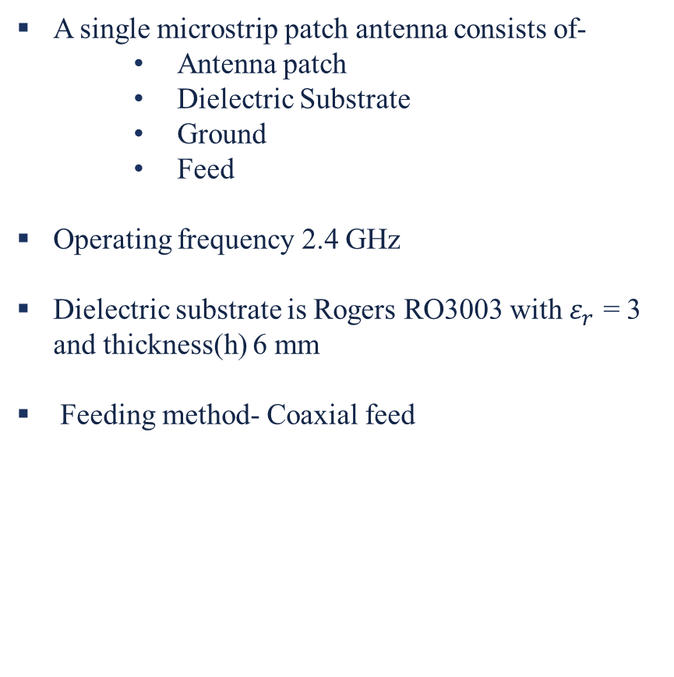
Design of Single Patch Antenna
A single microstrip patch antenna consists of-
Antenna patch
Dielectric Substrate
Ground
Feed
Operating frequency 2.4 GHz
Dielectric substrate is Rogers RO3003 with $ε_{r}$ = 3 and thickness(h) 6 mm
Feeding method- Coaxial feed
Substrate
Coaxial Feed Point
Ground
Port
Patch
Fig 1: Single Patch Antenna

Slide 7
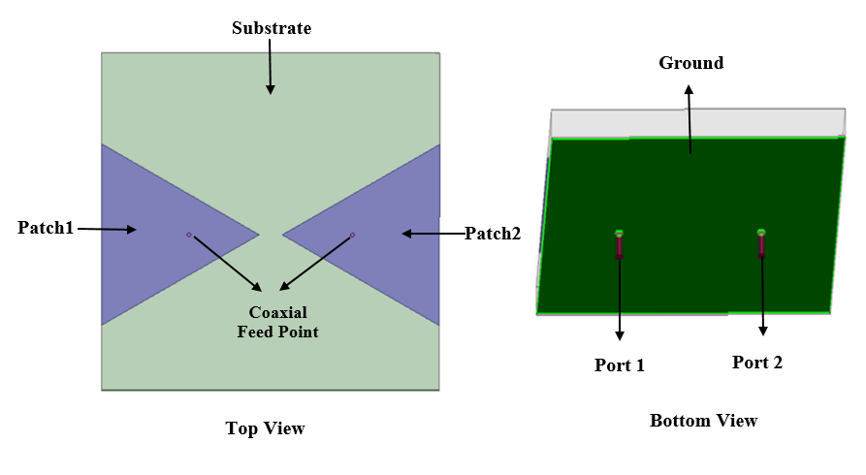
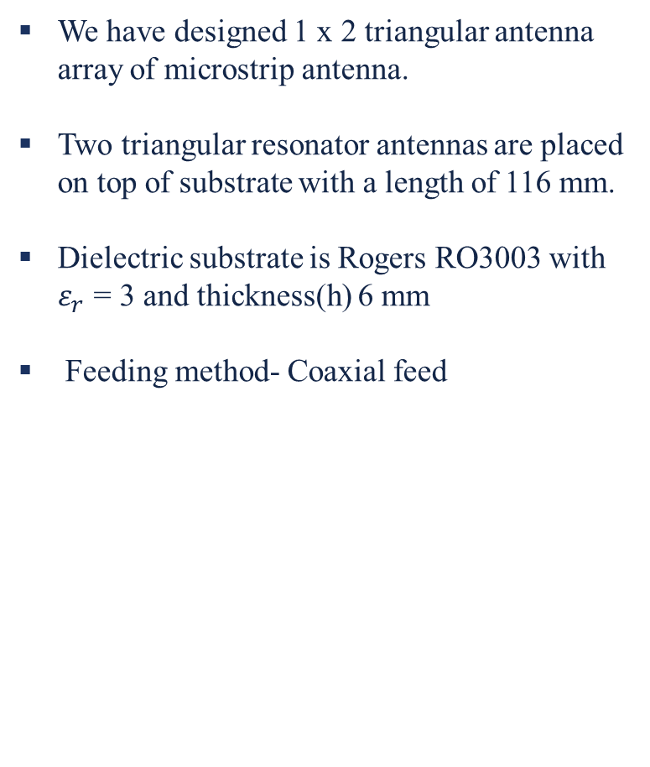
DESIGNING OF MIMO ANTENNA
We have designed 1 x 2 triangular antenna array of microstrip antenna.
Two triangular resonator antennas are placed on top of substrate with a length of 116 mm.
Dielectric substrate is Rogers RO3003 with $ε_{r}$ = 3 and thickness(h) 6 mm
Feeding method- Coaxial feed
Fig 2: MIMO Antenna

Slide 8
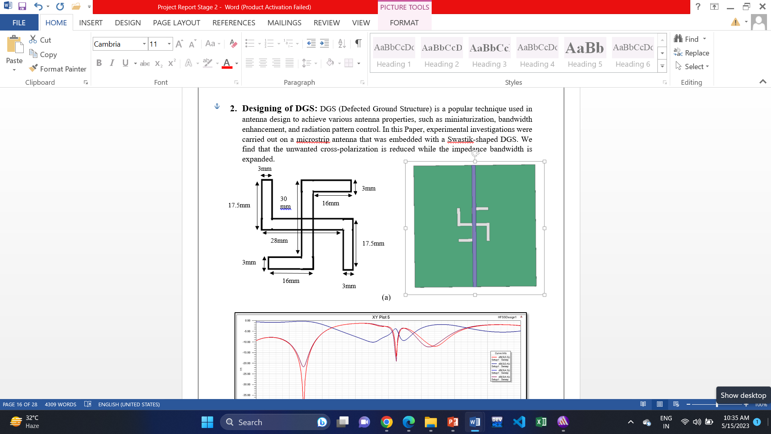
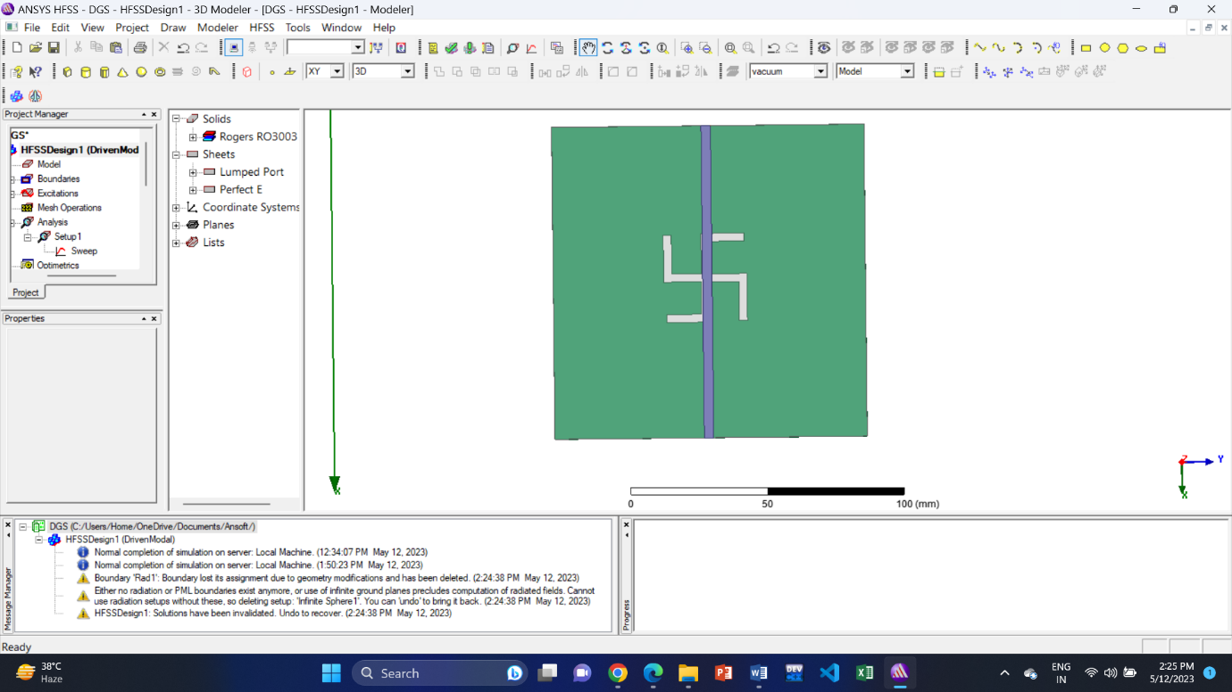
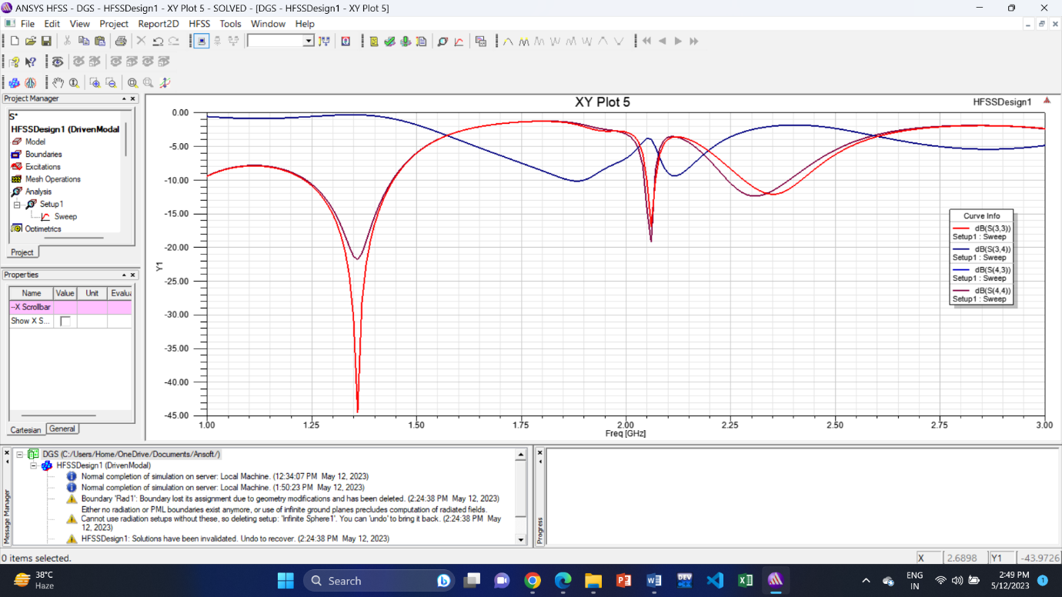
Designing of DGS
DGS (Defected Ground Structure) is a popular technique used in antenna design to achieve various antenna properties, such as miniaturization, bandwidth enhancement, and radiation pattern control.
The experimental investigations were carried out on a microstrip antenna that was embedded with a Swastik-shaped DGS.
(a)
Fig 3: (a) Swastik Shaped DGS Structure & (b) Result
(b)

Slide 9
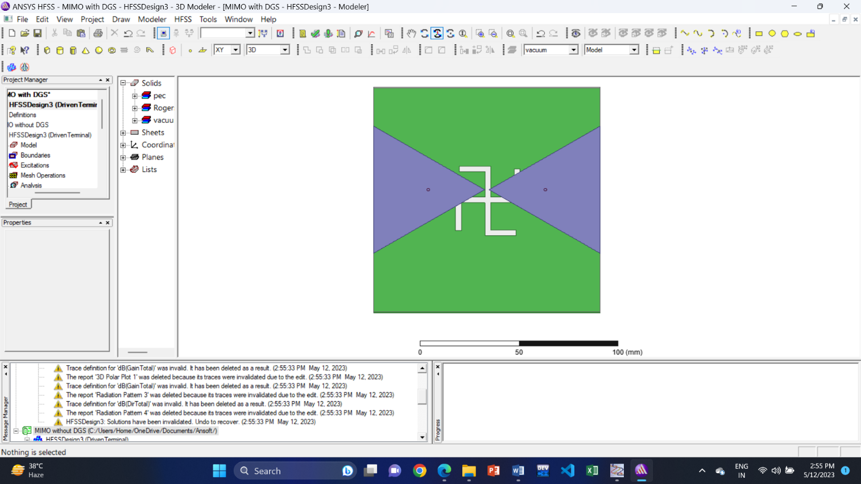
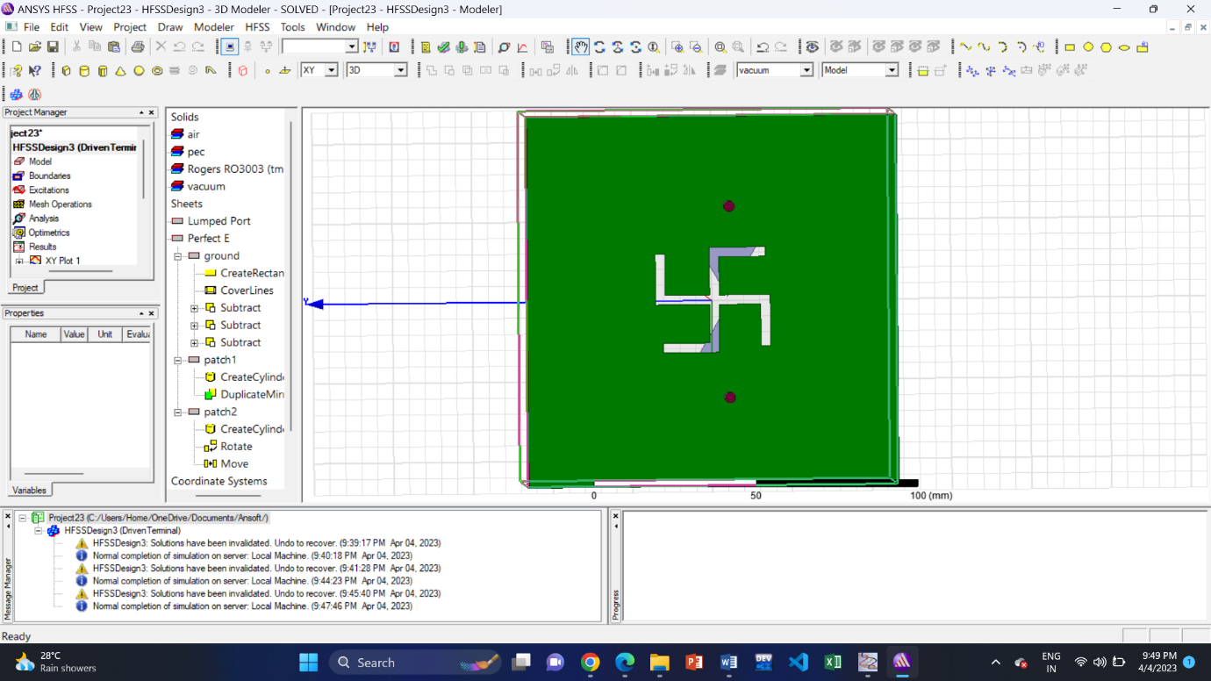
DESIGNING OF MIMO ANTENNA with dgs
In microstrip antennas, DGS is used for the enhancement of gain and bandwidth.
Here we have designed ‘swastik’ shaped DGS for better performance.
Fig 4: Top & Bottom View MIMO Antenna with DGS

Slide 10
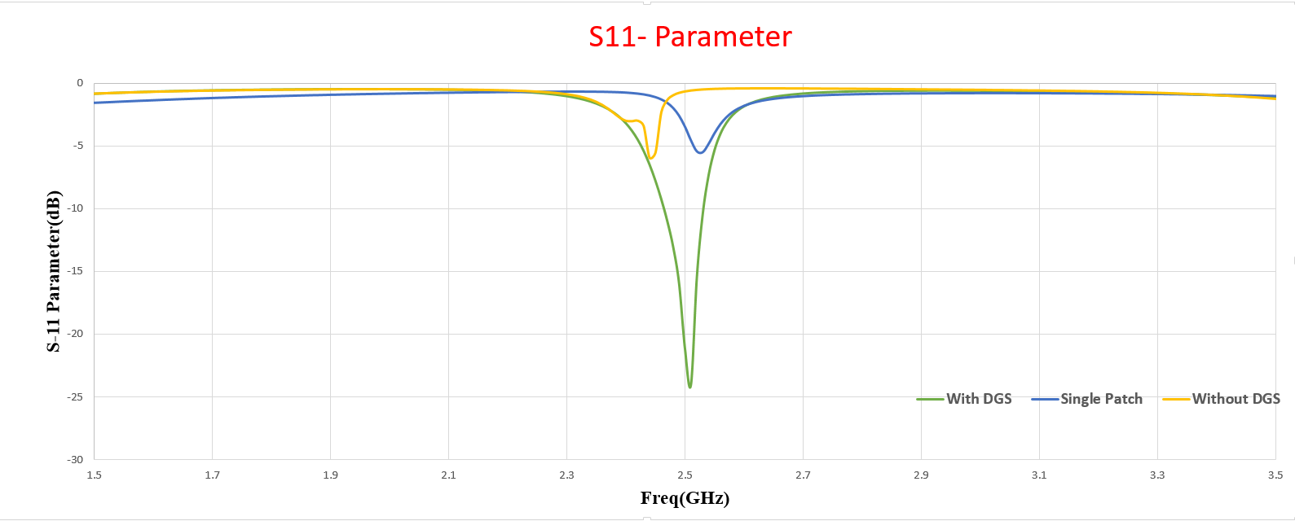
Result
Fig 5: S11 Parameter of Single Patch Antenna, MIMO Antenna with DGS & without DGS

Slide 11
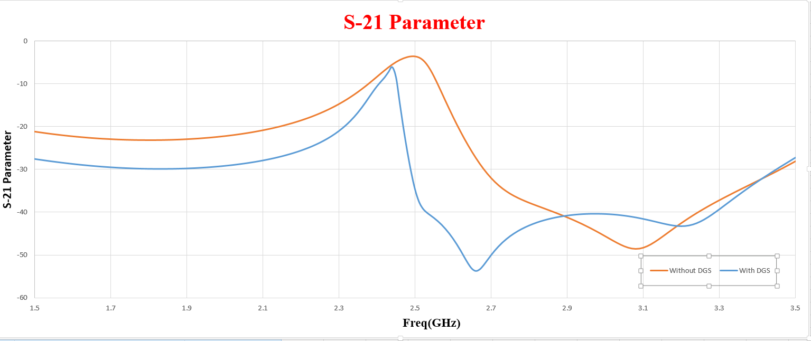
Fig 6: S21 Parameter of MIMO Antenna with DGS & without DGS

Slide 12
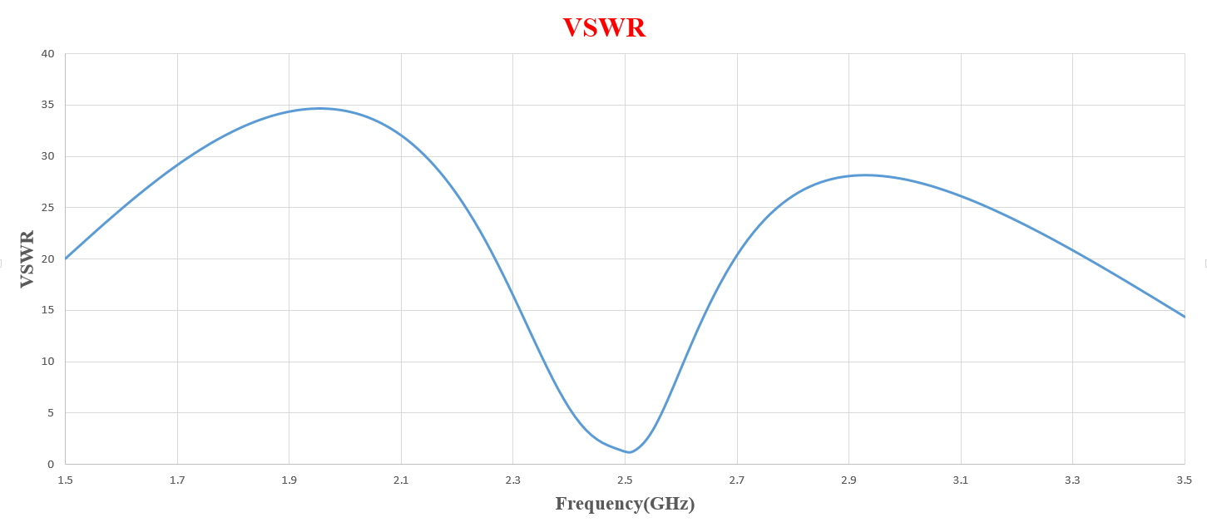
Fig 7: VSWR

Slide 13
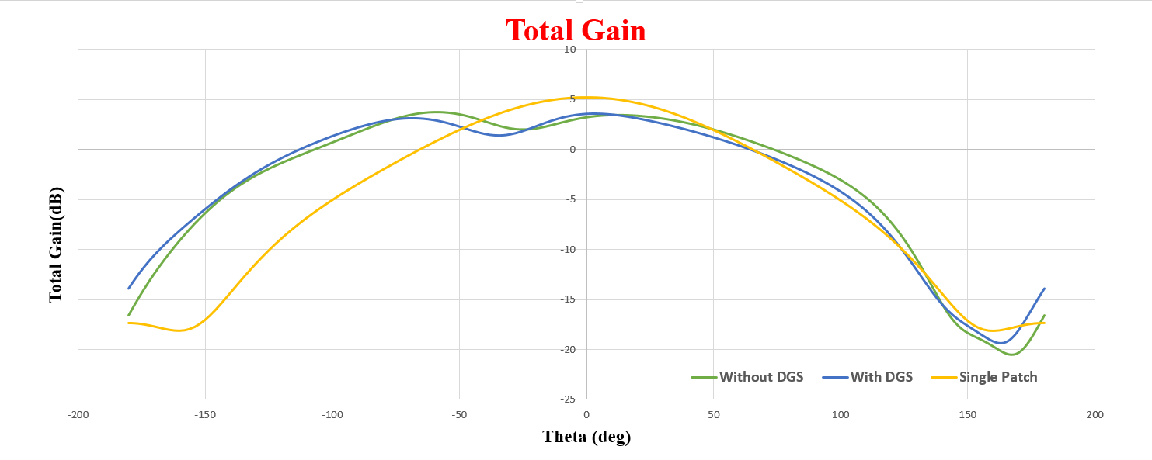
Fig 8: Total Gain of Single Patch Antenna, MIMO Antenna with DGS & without DGS

Slide 14
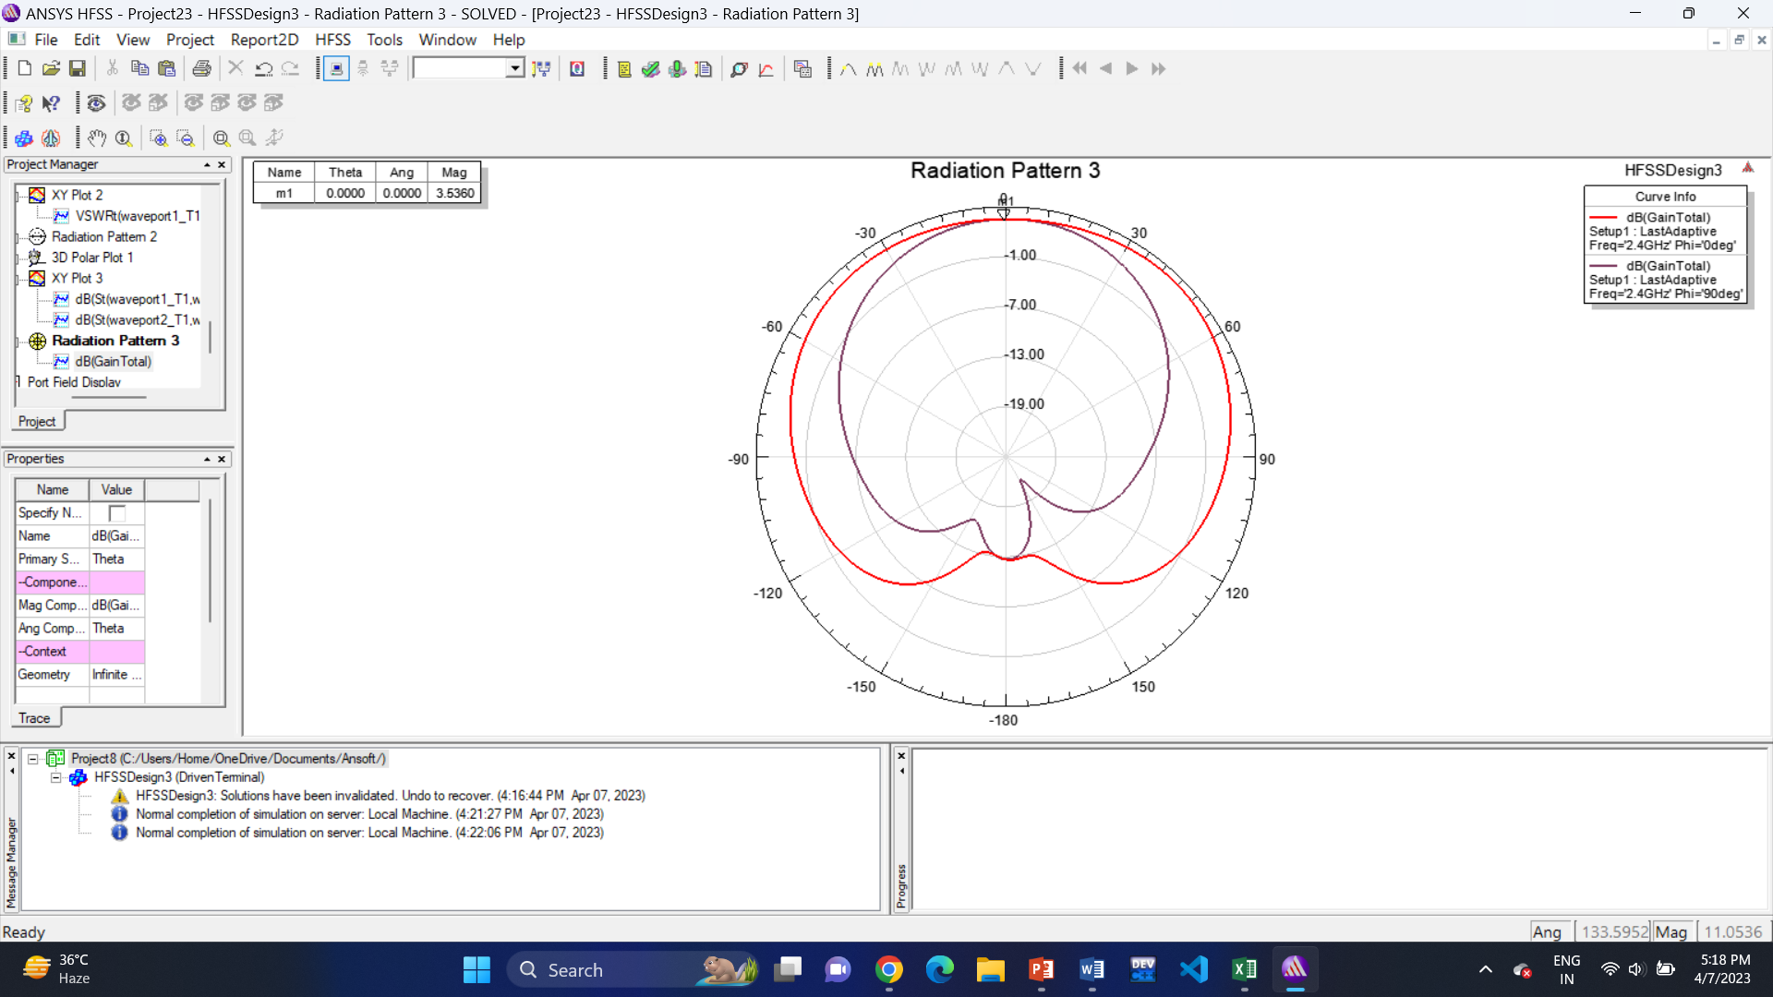
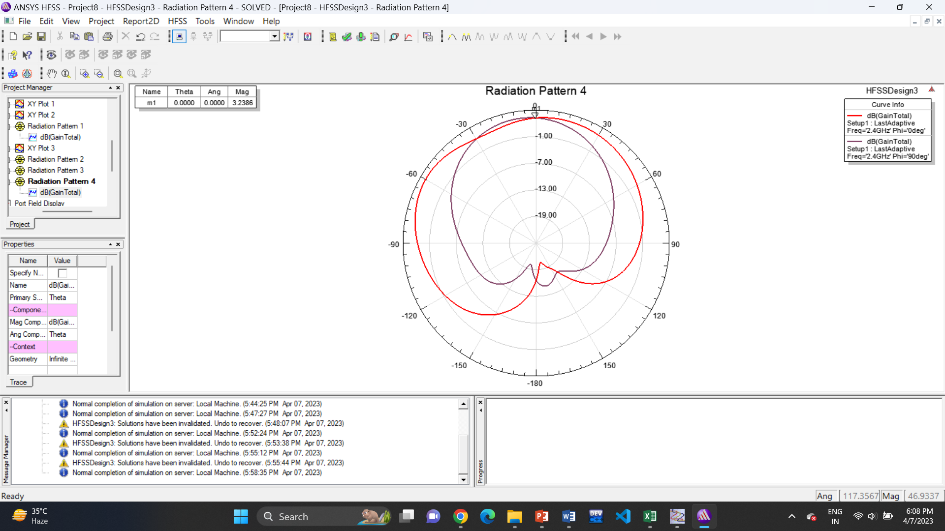
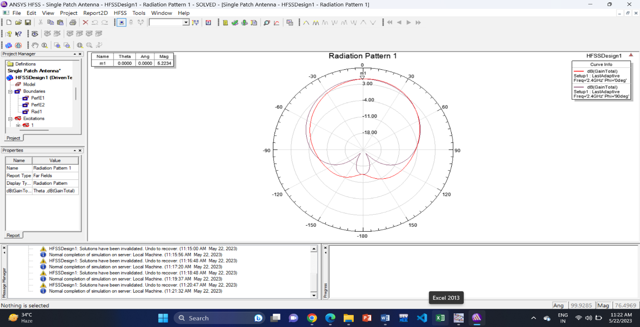
(b)
(c)
(a)
Fig 9: Radiation Pattern of MIMO Antenna (a) with DGS, (b) without DGS & (c) Single Patch Antenna

Slide 15
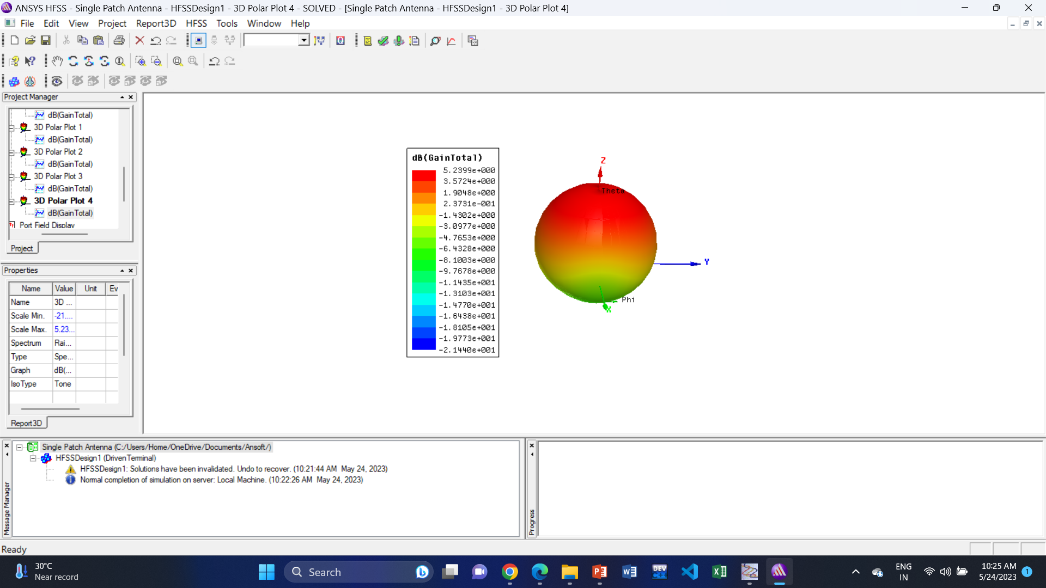
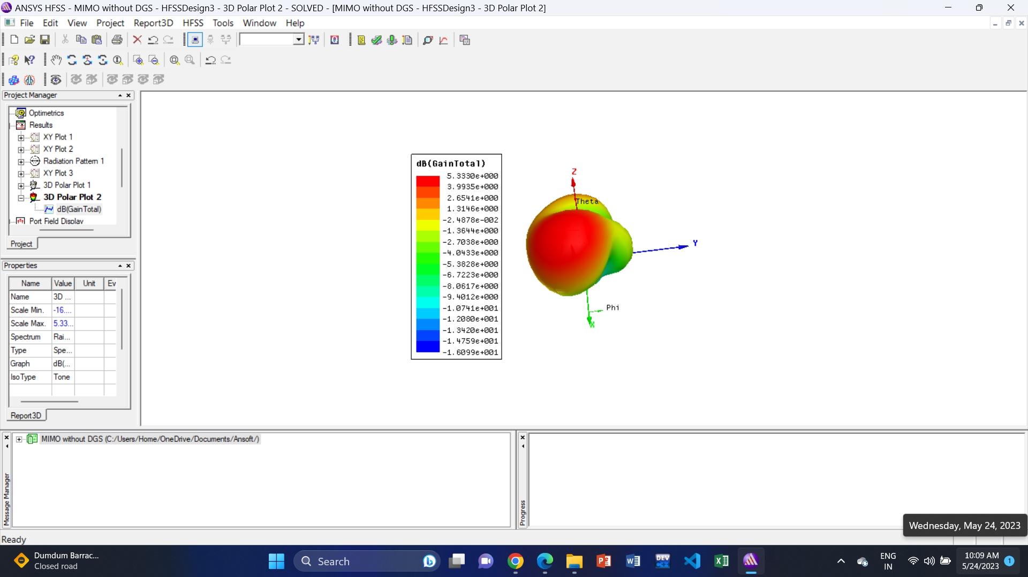
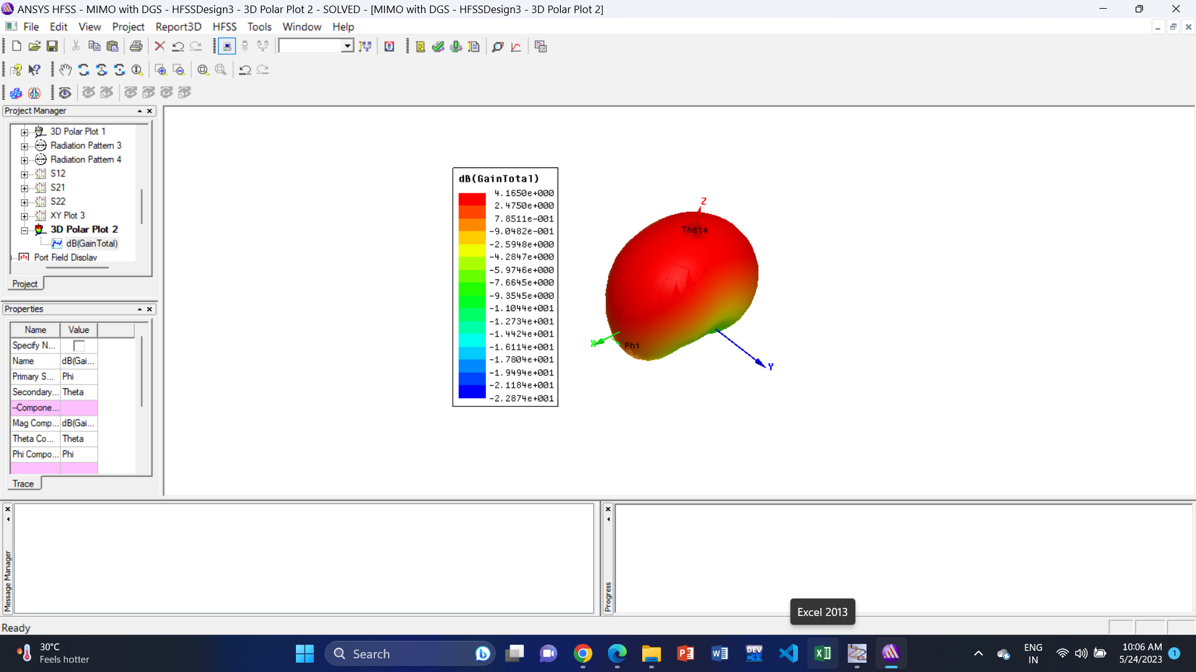
(a)
(b)
(c)
Fig 10: 3-D Polar Plot of (a) Single Patch Antenna, MIMO Antenna (b) without DGS & (c) with DGS

Slide 16
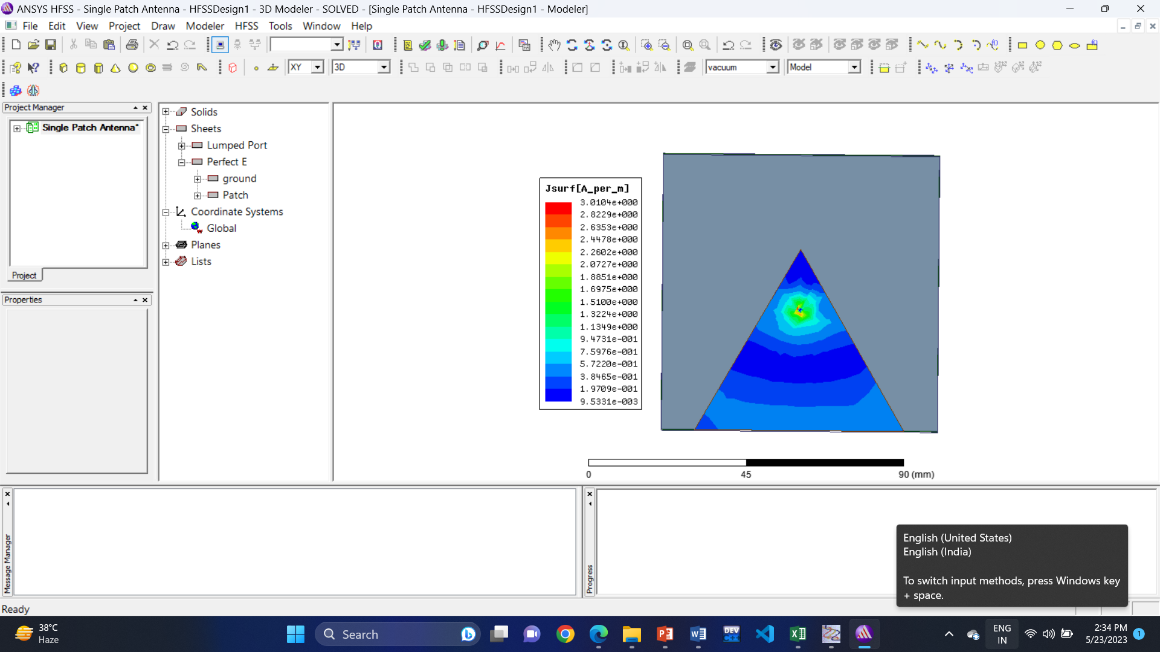
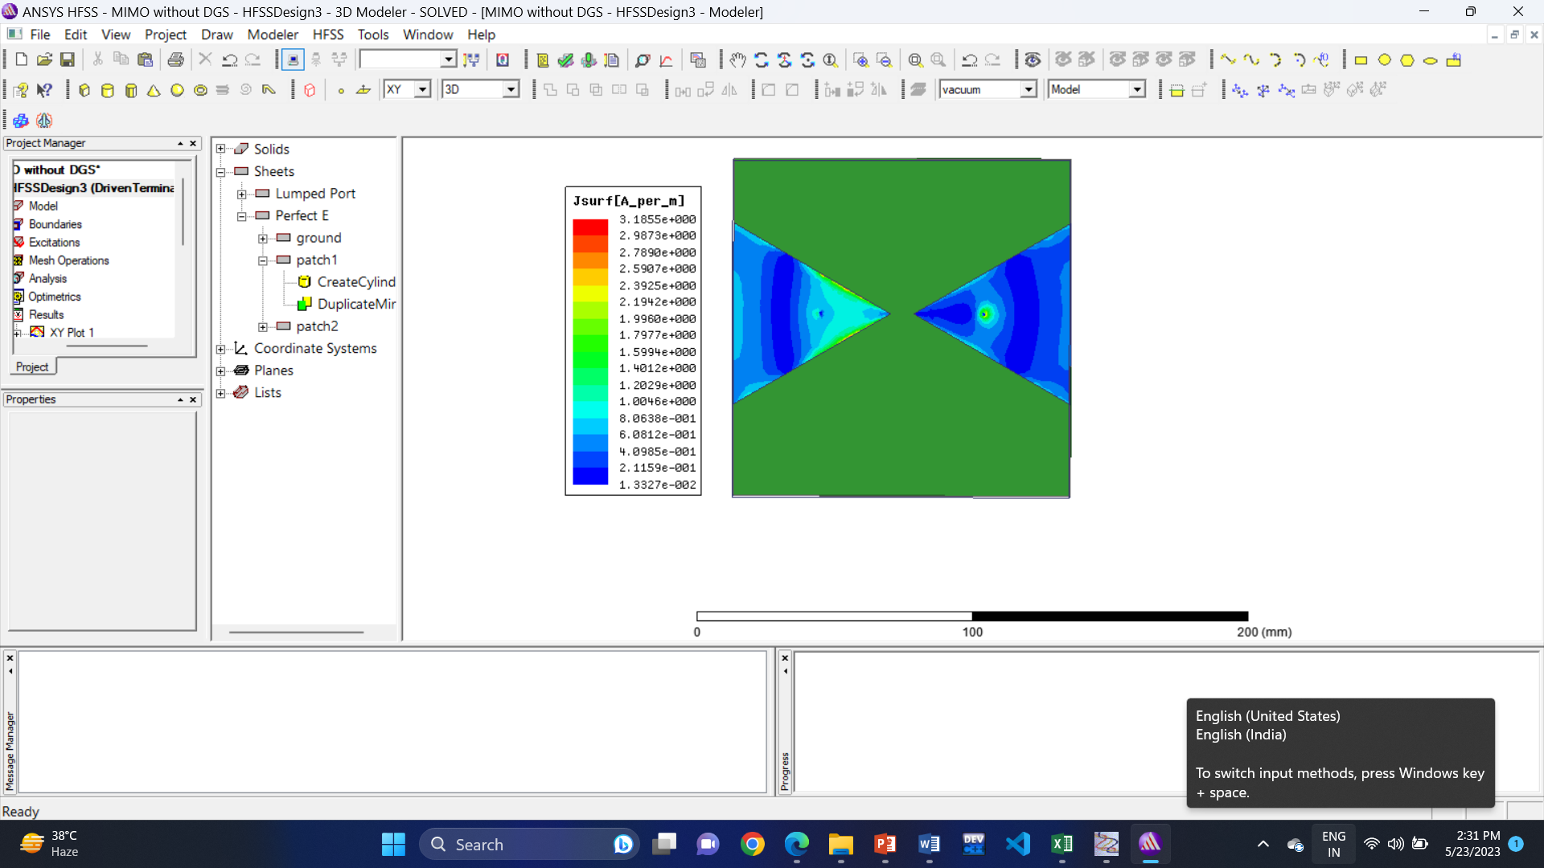
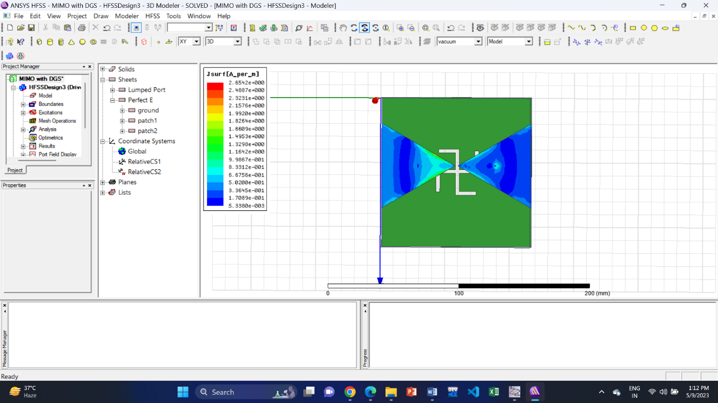

(a)
(b)
(c)
Fig 10: Current Distribution of (a) Single Patch Antenna, MIMO Antenna (b) without DGS & (c) with DGS

Slide 17
CONCLUSION
The proposed antenna is designed to operate at 2.4 GHz frequency band which is used for wireless communication in IoT devices, particularly for Wi-Fi and Bluetooth connectivity. Two triangular patch antennas are placed close to each other on a RO3003 substrate with a thickness of 6 mm, and DGS is used for isolation in the ground layer. The main purpose of DGS of different shapes is to obtain high cross-coupling reduction. In this paper, -53 dB was obtained using H-shaped DGS. Describes S11 parameters, S21 parameters, VSWR, total gain, directivity, radiation pattern. The obtained results are -24.05 dB, -53 dB, 1.13, 3.53 dB, 3.73 dB respectively for the above parameters at 2.4 GHz frequency. The proposed MIMO antenna is applicable for IoT applications and also in other practical scenarios.

Slide 18
Future Plan
Future plans for this project include publishing a research paper and, if necessary, further we will improve the results through ongoing experiments and simulations. Test this MIMO antenna with IoT devices. The 2.4 GHz band is widely used for wireless communication in IoT devices, particularly for Wi-Fi and Bluetooth connectivity. This band offers high data rates but has limited range and can be subject to interference from other devices operating in the same band. Common wireless technologies used in IoT applications include Wi-Fi, Bluetooth, WLAN, and ZigBee, which operate in the 2.4 GHz frequency band.

Slide 19
REFERENCES
[1] C. A. Balanis, Antenna Theory: Analysis and Design, 2nd Ed. Wiley India Pvt. Limited, 2007.
[2] https://www.antenna-theory.com/antennas/patches/antenna.php
[3] https://www.rfpage.com/mimo-technology-in-wireless-communication/
[4] Asif Khan, Suiyan Geng, Xiongwen Zhao, Zahoor Shah, Mishkat Ullah Jan, Mohamed Abdelkarim Abdelbaky. Design of MIMO Antenna with an Enhanced Isolation Technique. Electronics 2020, 9(8), 1217.
[5] N.O. Parchin, Y.I.A. Al-Yasir, A.H. Ali, I. Elfergani, J.M. Noras, J. Rodriguez, R.A. Abd-Alhameed. Eight-element dualpolarized MIMO slot antenna system for 5G smartphone applications. IEEE Access 2019, 7, 15612–15622.
[6] Mohammad S. Sharawi, Muhammad Ikram, Atif Shamim. A two concentric slot loop based connected array MIMO antenna system for 4G/5G terminals. IEEE Trans. Antennas Propag. 2017, 65, 6679–6686.

Slide 20

Thank You

